Slide 1
Data Analysis and Validation on OncoKB, GatewaySeq, and MyeloSeq-HD
Justin Caringal & Ajay Khanna, Dr. Eric Duncavage Lab
Washington University of Saint Louis
Department of Pathology & Immunology

Slide 2
Analysis of OncoKB API Calls in GatewaySeq
Notes:
https://pathologyservices.wustl.edu/items/gatewayseq-ngs-panel-with-interpretation/

Slide 3
Starting Point and Goals
GatewaySeq: A tumor-only, high coverage targeted next generation sequencing assay for the identification of gene mutations, copy number alterations, microsatellite instability, tumor mutational burden, and gene fusions
Evaluate three different methods for looking up variants in OncoKB from MSKCC via web API for interpretation provided to physicians
byGenomicChange, byProteinChange, byHGVSg
BRAF →
7,140453136,140453136,A,T
p.V600E
7:g.140453136A>T
https://pathologyservices.wustl.edu/items/gatewayseq-ngs-panel-with-interpretation/
Notes:
gateway seq new assay from pathology for high coverage analysis of (cut down)
A tumor-only, high coverage targeted next generation sequencing assay for the identification of gene mutations, copy number alterations, microsatellite instability, tumor mutational burden, and gene fusions.
Interpretation uses oncokb from mskcc via web api evaluate different methods for query of variants
Evaluate three different methods for looking up variants in oncokb via web api for interpretation provided to physicians
Gen
Pro
Hgvsg
Won't go into detail, uses diff methods, genomic coordinates, hgvsg strings, protein locations, etc
Input data: every variant run through gatewayseq (so far)
Output: comparison table of every variant lookup using three different methods (gen, pro, hgvsg), annotated with relevant information
Elapsed time measured, negligible

Slide 4
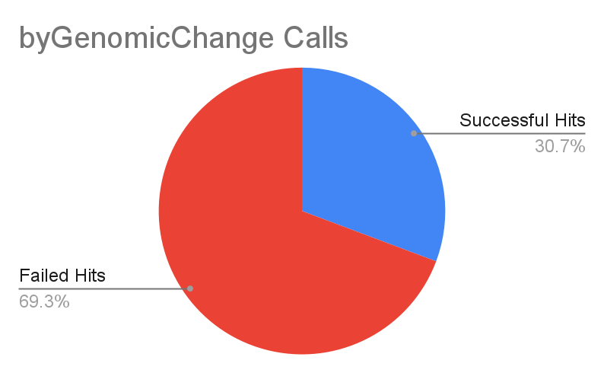
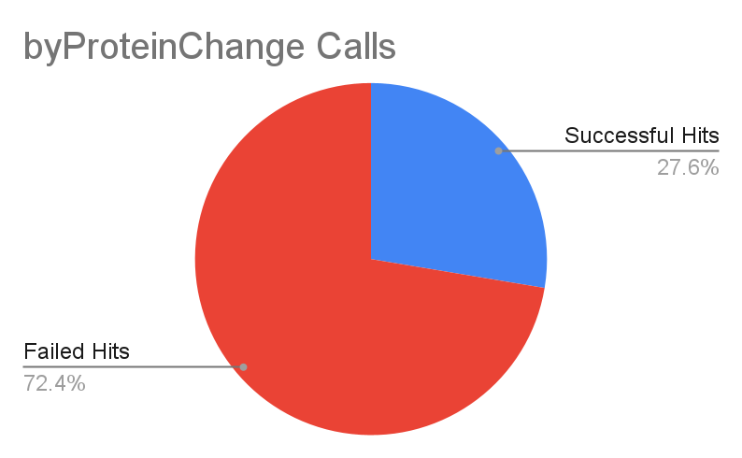
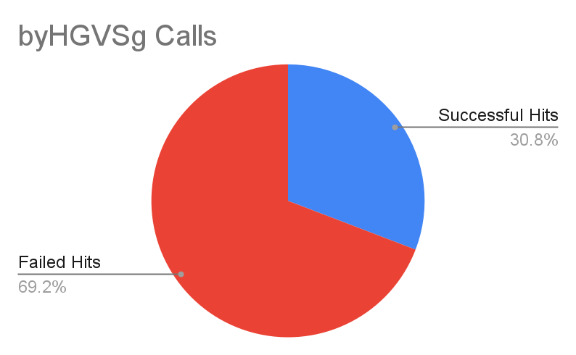
 | Successful Hits | Failed Hits
Genomic | 538 | 1214
Protein | 484 | 1268
HGVSg | 540 | 1212
Total Searches | 1752
Table Annotations (142 Samples)
Comparisons | Differences
Genomic vs. Protein | +60
Genomic vs. HGVSg | -2
Protein vs. HGVSg | -60
Notes:
Input data: every variant run through gatewayseq (so far)
Output: comparison table of every variant lookup using three different methods (gen, pro, hgvsg), annotated with relevant information
Elapsed time measured, negligible

Slide 5
Discrepancies between GatewaySeq and OncoKB
AKT1
ATM
B2M
CD79B
CHEK1
DICER1
FGFR1
HRAS
ITPKB
MYD88
NF1
NFKBIE
NTRK3
PAX8
PTPRD
RAD51B
RSPO3
SGK1
SMARCA4
SMARCB1
TCF3
TFEB
TNFAIP3
OncoKB and GatewaySeq differed in choice of gene transcript
GatewaySeq uses the Ensembl Canonical transcript
AA coordinates may differ, could affect lookups
Gene/Transcript | 1752
Correct ID | 1489
Incorrect ID | 263
Discrepancy Frequency | 0.15
Notes:
Could be interesting
We don't know why, but of interest
“Just smth interesting; failed via protein method”

Slide 6
GatewaySeq Conclusion
Overall, small differences between API calls
byProteinChange lagged behind both byGenomicChange and byHGVSg
In cases of successful hit discrepancies
byProteinChange failure: No p.syntax available (e.g. splice variant)
byGenomicChange failure: Complex variants may not be found
HGVSg is marginally better than Genomic
Example: ARID1A, ENST00000324856 (PASS) TAG→AA, complex variant
Future Directions: Might be better to use byHGVSg in the pipeline
Notes:
When the variant was not an amino acid substitution, ergo didn't have a p.syntax string, c.syntax was used (occurs in things like splice variants)
“No p.syntax available (e.g. splice variant)”
Complex variant = variant annotated cc → aa (etc.) smth other than simple indel or snv

Slide 7
Coverage Comparisons In MyeloSeq-HD

Slide 8
MyeloSeq-HD
Targeted sequencing assay for 49 genes and gene hotspots that are recurrently mutated in myeloid neoplasms, such as MDS and AML
Uses a high coverage UMIs-based error corrected sequencing approach to achieve >95% sensitivity for previously identified mutations with VAFs ≥0.25%
https://pathologyservices.wustl.edu/items/myeloseq/
Notes:
Include background information on myeloseq → https://pathologyservices.wustl.edu/items/myeloseq/
A targeted sequencing assay for 49 genes and gene hotspots that are recurrently mutated in myeloid neoplasms, such as MDS and AML. This assay is intended to be used for both initial diagnosis and measurable/minimal residual disease (MRD) monitoring. MyeloSeq-HD uses a high coverage (12Gbases [20,000x bases]) unique molecular identifiers (UMIs)-based error corrected sequencing approach to achieve >95% sensitivity for previously identified mutations with VAFs ≥0.25%; sensitivity for newly detected variants is limited to 2% VAF. For post allogeneic hematopoietic stem cell transplant patients, MyeloSeq-HD can detect mixed chimerism.

Slide 9
Read Coverage
New MyeloSeq-HD feature:
For previously identified variants, limit of detection (LOD) depends on sampling error
Sampling error depends on coverage
Paired-End Sequencing reads can overlap with small enough fragment sizes
What is the coverage of loci in overlaps, 1 (collapsed) or 2?
>>>>>>>>>>>>>>>>>> read 1
--------------x----------------- fragment x: locus
<<<<<<<<<<<<<<<<<<<< read2

Slide 10
General Pipeline
MyeloSeq-HD coverage:
Dragen aligns FASTQ files, paired-end sequencing (150 base pairs), reports region coverage → BED
Call specific variants (Dragen, Pindel, combination) → VCF/JSON
Pindel & Dragen-Pindel uses custom Python script
Goal: Compare output VCF and BED coverage to measure discrepancies
Notes:
Include background information on myeloseq → https://pathologyservices.wustl.edu/items/myeloseq/
A targeted sequencing assay for 49 genes and gene hotspots that are recurrently mutated in myeloid neoplasms, such as MDS and AML. This assay is intended to be used for both initial diagnosis and measurable/minimal residual disease (MRD) monitoring. MyeloSeq-HD uses a high coverage (12Gbases [20,000x bases]) unique molecular identifiers (UMIs)-based error corrected sequencing approach to achieve >95% sensitivity for previously identified mutations with VAFs ≥0.25%; sensitivity for newly detected variants is limited to 2% VAF. For post allogeneic hematopoietic stem cell transplant patients, MyeloSeq-HD can detect mixed chimerism.

Slide 11
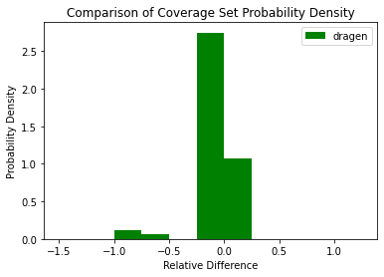
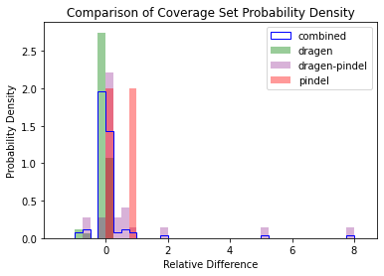
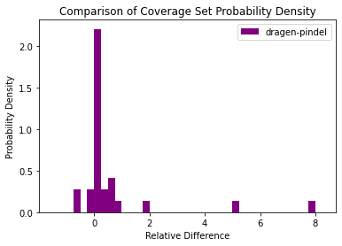
Comparisons (Tier 1-3 Variants)
Pindel not shown (2 cases)

Slide 12
Comparisons (Tier 1-3 Variants)
 | dragen | pindel | dragen-pindel
Total extractions | 67 | 2 | 29
Average Relative Difference | -0.03362 | 0.47623 | 0.599
Average Difference in Coverage | -85.46269 | 249.5 | 292.06897
Absolute differences greater than 50 | 5 (7.46%) | 1 (50%)* | 16 (55.17%)
*sample too small to make any meaningful conclusions

Slide 13
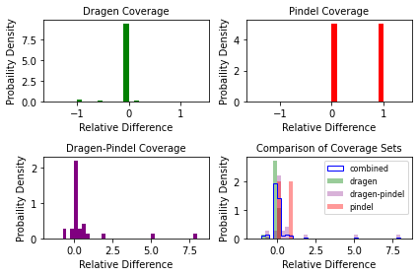
MyeloSeq-HD Conclusion
Dragen is the preferred method
<8% over 50 ( | JSON – BED | )
Data on Pindel is too small to draw meaningful conclusions
Only two Pindel TIER 1-3 variants in Batch 247
Dragen-Pindel more prone to wild swings
Future Directions: Integrating more Dragen, more data on Pindel
Notes:
Include background information on myeloseq → https://pathologyservices.wustl.edu/items/myeloseq/
A targeted sequencing assay for 49 genes and gene hotspots that are recurrently mutated in myeloid neoplasms, such as MDS and AML. This assay is intended to be used for both initial diagnosis and measurable/minimal residual disease (MRD) monitoring. MyeloSeq-HD uses a high coverage (12Gbases [20,000x bases]) unique molecular identifiers (UMIs)-based error corrected sequencing approach to achieve >95% sensitivity for previously identified mutations with VAFs ≥0.25%; sensitivity for newly detected variants is limited to 2% VAF. For post allogeneic hematopoietic stem cell transplant patients, MyeloSeq-HD can detect mixed chimerism.

Slide 14
Dragen (67 variants)
JSON-BED
2496
2496
486
-9 to 0 (57)
-10
-11
-20
-78
-1664
-1778
-3865
Coverage: order of thousands
Most (57/67) were near-identical (-9 to 0)
Examined NRAS variant alignments
With Samtools mpileup (-Q10 -q20), able to reproduce JSON (variant caller) coverage of 5664
May want to generate own coverage, or look at options for Dragen BED (region) coverage
CHROM POS REF ALT GENE JSON BED JSON-BED
chr1 114716127 C T NRAS 5664 7442 -1778
Notes:
Include background information on myeloseq → https://pathologyservices.wustl.edu/items/myeloseq/
A targeted sequencing assay for 49 genes and gene hotspots that are recurrently mutated in myeloid neoplasms, such as MDS and AML. This assay is intended to be used for both initial diagnosis and measurable/minimal residual disease (MRD) monitoring. MyeloSeq-HD uses a high coverage (12Gbases [20,000x bases]) unique molecular identifiers (UMIs)-based error corrected sequencing approach to achieve >95% sensitivity for previously identified mutations with VAFs ≥0.25%; sensitivity for newly detected variants is limited to 2% VAF. For post allogeneic hematopoietic stem cell transplant patients, MyeloSeq-HD can detect mixed chimerism.

Slide 15
Dragen-Pindel (29 Variants)
JSON-BED
4629
2683
1734
1683
1624
650
615
578
473
445
432
286
174
98
11
0 to 5 (11)
-33
-3056
-4187
Many more large discrepancies
Tends to be higher in JSON (variant caller)
Possibly due to filtering script
Did not have time to investigate further
We are thinking about removing filtering script
Pindel-only contains 2 cases
Notes:
Include background information on myeloseq → https://pathologyservices.wustl.edu/items/myeloseq/
A targeted sequencing assay for 49 genes and gene hotspots that are recurrently mutated in myeloid neoplasms, such as MDS and AML. This assay is intended to be used for both initial diagnosis and measurable/minimal residual disease (MRD) monitoring. MyeloSeq-HD uses a high coverage (12Gbases [20,000x bases]) unique molecular identifiers (UMIs)-based error corrected sequencing approach to achieve >95% sensitivity for previously identified mutations with VAFs ≥0.25%; sensitivity for newly detected variants is limited to 2% VAF. For post allogeneic hematopoietic stem cell transplant patients, MyeloSeq-HD can detect mixed chimerism.

Slide 16
THANK you!
Special thanks to the Spencer Lab!
Questions?
Please keep this slide for attribution

Slide 17


Slide 18
Goals
Remove: slide 4
Implement similar structures using OncoKB API calls to byProteinChange and byHGVSg
Explore JSON-to-table generation and annotation
Compare API calls
Elapsed time
Successful hits

Slide 19
Example: TWJV-Gateway-Seq-S16-474-lib2.report.json
Remove: slide 5
 | byGenomicChange | byProteinChange | byHGVSg
Total PASS | 7 | 7 | 7
Skipped PASS | 0 | 0 | 0
Annotated PASS | 2 | 2 | 2
Total Filtered | 26 | 26 | 26
Skipped Filtered | 0 | 0 | 0
Annotated Filtered | 3 | 3 | 3
Total Annotated | 5 | 5 | 5
Elapsed (secs) | 37.475 | 38.758 | 34.927
Implemented Elapsed time feature to be cross-compatible between machines

Slide 20
JSON-to-Table Method
Remove: slide 6
JSON → annotated JSON comparison inefficient
Unique variant duplicates increases query time
Queries for each specific tumor type
JSON → table → annotated table more efficient
Removes duplicates
General query for information
Easier to analyze

Slide 21
Elapsed Time
Remove: slide 8
 | byGenomicChange | byProteinChange | byHGVSg
Total (secs) | 390.918 | 299.029 | 318.2
Mean (secs) | 0.223 | 0.171 | 0.182
Variance (secs²) | 0.04379 | 0.03104 | 0.02863
Standard Deviation (secs) | 0.209 | 0.176 | 0.169
Approx. Total Elapsed Time (secs) |  |  | 1008.147
Total Elapsed, Standard Formatting |  | 16 min, 48.147 secs

Slide 22
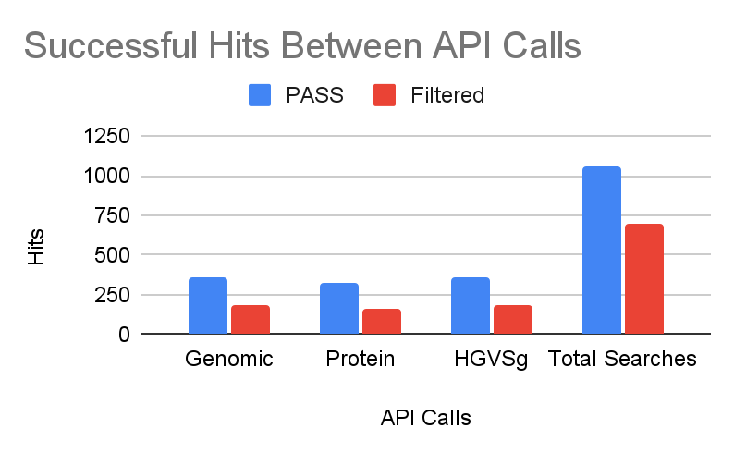
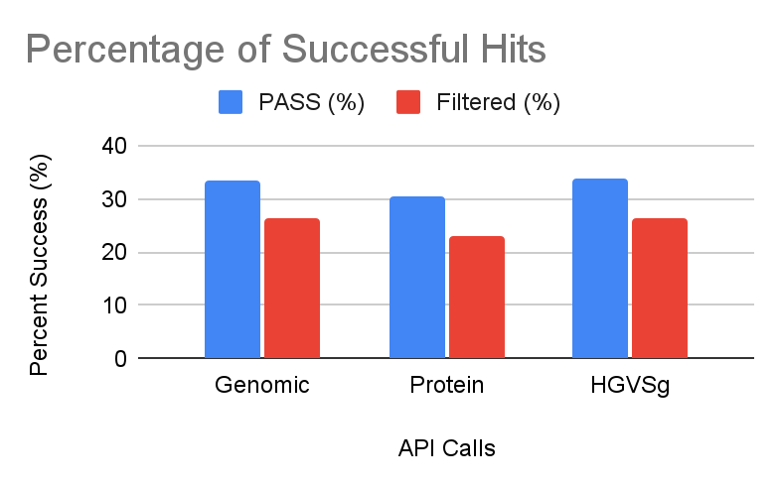
Remove: slide 9
PASS vs. Filtered Variants
 | PASS | Filtered | PASS (%) | Filtered (%)
Genomic | 356 | 182 | 33.62 | 26.26
Protein | 325 | 159 | 30.69 | 22.94
HGVSg | 358 | 182 | 33.81 | 26.26
Total Searches | 1059 | 693
Notes:
Include based on time
If included,
PASS - normally be reported
Filtered - normally not be reported
Looked at filtered to have a larger dataset

